Slide 1
Final Projects
Lesson 23.1

Slide 2
Class Objectives
By the end of today’s class you will be able to:
Familiarize yourselves with the MNIST dataset for handwriting recognition.
Load an image file into a data array.
Use pretrained models to make predictions.
Make progress on your projects.

Slide 3
MNIST
Notes:
🎉 1.1 Everyone Do: MNIST (25 min)

Slide 5
Intro to Final Projects
Notes:
📣 2.1 Instructor Do: Intro to Final Projects (15 min)

Slide 6
Project Week (This Week)!
Day 1 | Form groups.
 | Outline project ideas.
 | Perform an initial data exploration.
 | Begin research of datasets.
 | Submit a project proposal for approval.
Day 2 & 3 | Develop your project with your team.

Slide 7
Project Week (Next Week)!
Day 4 | Develop your project with your team.
Day 5 | Develop your project with your team and prepare your presentation.
Day 6 | Present your project to the class.

Slide 8
Project Requirements

Slide 9
Final Project Requirements: Demystifying ML
01
Find a problem worth solving, analyzing, or visualizing.
02
Use machine learning (ML) with the technologies we’ve learned.
03
You must use Scikit-learn and/or another machine learning library.
04
You must use at least two of the following:
Python Pandas Python Matplotlib | HTML/CSS/Bootstrap JavaScript Plotly JavaScript Leaflet | Tableau SQL Database MongoDB Database | Google Cloud SQL Amazon AWS

Slide 10
Project 4 Group Work
The requirements for this project are broken into 5 categories:
Data and data delivery
Back end (ETL)
Visualizations
Group presentations
Slide deck

Slide 11
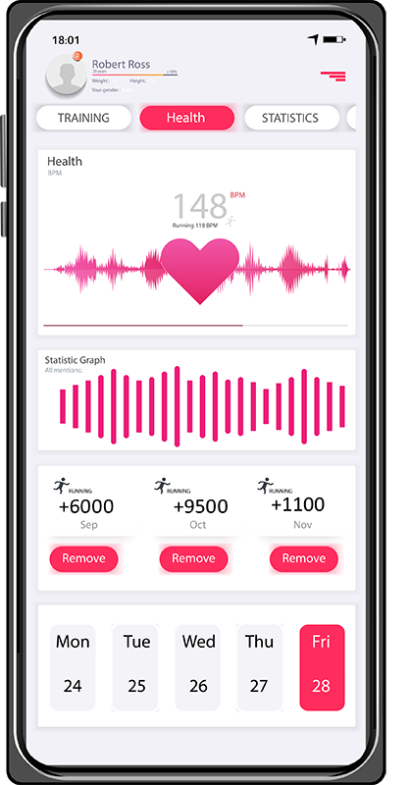


Project Group Work
You can focus on:
Finance
Healthcare
Custom

Slide 13
Project Examples

Slide 14
Final Project Requirements: Demystifying ML in Finance
Example finance-related projects:
Create an algorithm that analyzes credit scores and predicts consumer personal-loan eligibility.
Using natural language processing, create a chatbot to perform simple tasks and help users find information.
Train an algorithm to analyze consumer spending and predict trends.
Train an image classifier to assess property value, which could then be used to calculate insurance quotes.

Slide 15
Final Project Requirements: Demystifying ML in Healthcare
Example healthcare-related projects:
Train an algorithm to recognize disease symptoms and predict if a patient is at risk.
Train an image classifier to recognize anomalies, such as suspicious vs healthy areas of skin.
Using natural language processing, create a chatbot that will help connect patients with doctors.
Create an algorithm to analyze patient history and predict the likelihood of inherited illness.

Slide 16

Final Project Requirements: Demystifying ML
Prepare a 15-minute data deep dive or infrastructure review that shows machine learning in the context of what we’ve already learned.
Project ideas:
Create a front-end interface that maps to an API to “smarten” the algorithm.
Perform a deep dive on existing data using machine learning.
Create a visualization that continues to learn where clusters lie based on ML
(use Leaflet or Plotly to change the visualization).
Create an idea using mock data, and simulate how machine learning might be used.
Create an analysis of existing data to make a prediction, classification, or regression.

Slide 17
The key is to show the
value of what you know.

Slide 18
Project Work
125 Minutes
Notes:
✏️ 2.2 Students Do: Project Work (125 min)

Slide 19


Project Work: AWS
Remember to closely monitor any AWS resources that you choose to use.
It’s crucial that you clean up and stop, or shut down any AWS resources to avoid accruing additional costs.
Double-check your billing costs.

Slide 20
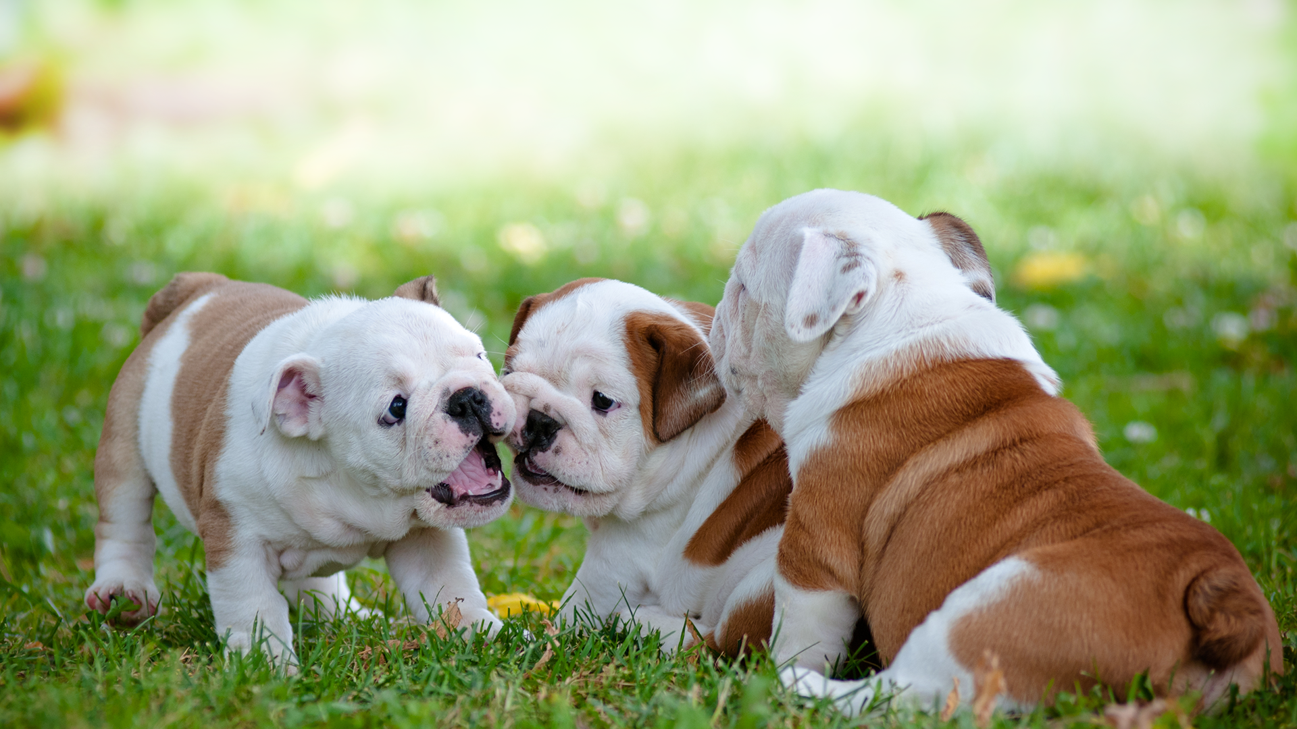
Time to divide into teams!
Notes:
shutterstock_81648802

